Slide 1
Add Human-side in Your Apps with Microsoft Cognitive Services
Eric ShangKuan
Sr. Technical Evangelist
Microsoft Taiwan

Slide 2
Democratizing AI
For every person and organization
Parts 2: Data & Part 3: Apps
Today’s Focus
Agents
Applications
Services
Infrastructure

Slide 3
Microsoft AI Portfolio
Agent
Applications
Services
Infrastructure
Cortana
Office 365
Dynamics 365
SwiftKey
Pix
Customer Service and Support
Skype
Calendar.help
Bot Framework
Cognitive Services
Cortana Intelligence
Cognitive Toolkit
Azure Machine Learning
Azure N Series
FPGA

Slide 4
Our Approach to AI Infrastructure & Services
Cognitive services
Bot framework
Easy to consume AI for developers
Data Science tools – Azure ML, Microsoft R Data preparation, modeling, and operationalization
Comprehensive ML and AI capabilities for Data Scientists
Algorithms – CNTK, TLC
Best of Microsoft research and open source
Unique data assets
Rich data sources to enrich predictions and models
Analytics Engines on Big Data Stores – HDInsight, Data Lake
(cloud + on premises)
Flexible infrastructure support for analytics and data engineers
Hyperscale hardware innovation (scale, GPU, FPGA) – Azure Compute
Leading hardware, at scale, on demand

Slide 5
Bing image search
Speech API
Entity linking
Customer feedback analysis
Bing news search
Speech
Text to speech
Custom recognition (CRIS)
Forecasting
Language
Recommendation API
Machine Learning
Text analytics
Thumbnail generation
Cognitive Services APIs
Academic knowledge
Spell check
Web language model
Knowledge
Bing autosuggest
Computer vision
Vision
Emotion
Anomaly detection
Sentiment scoring
Search
OCR, tagging, captioning
Bing web search

Slide 6

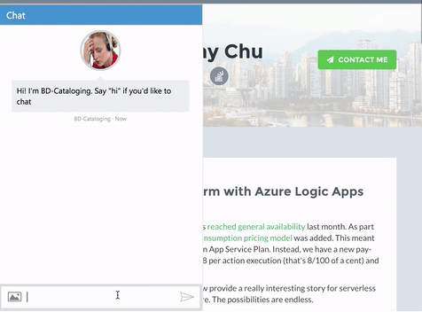
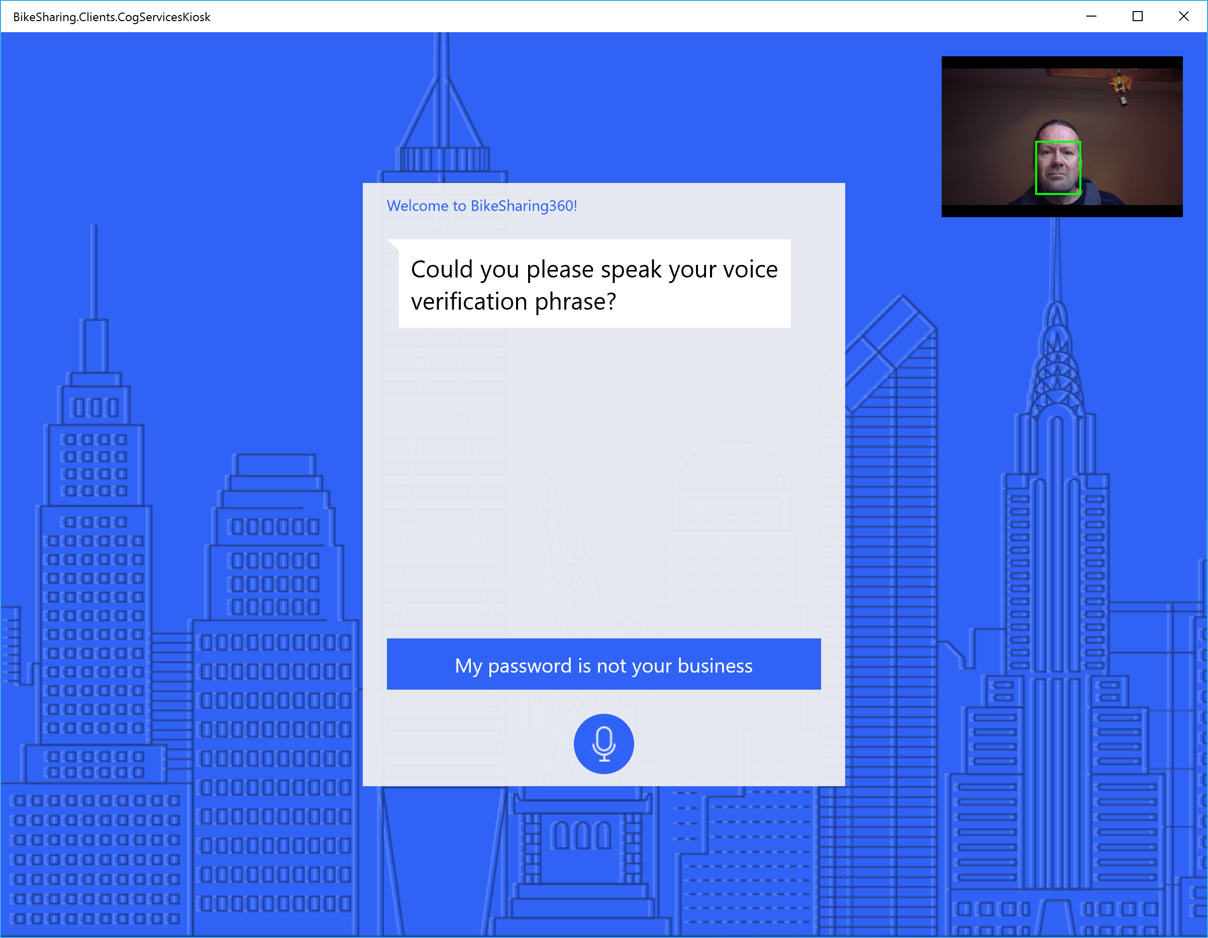


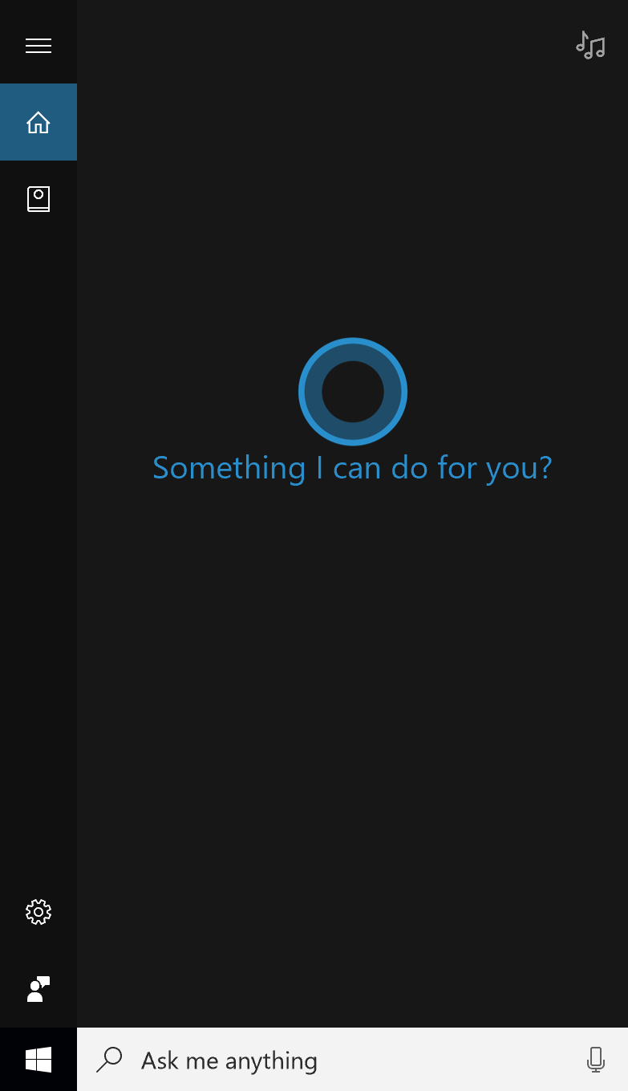
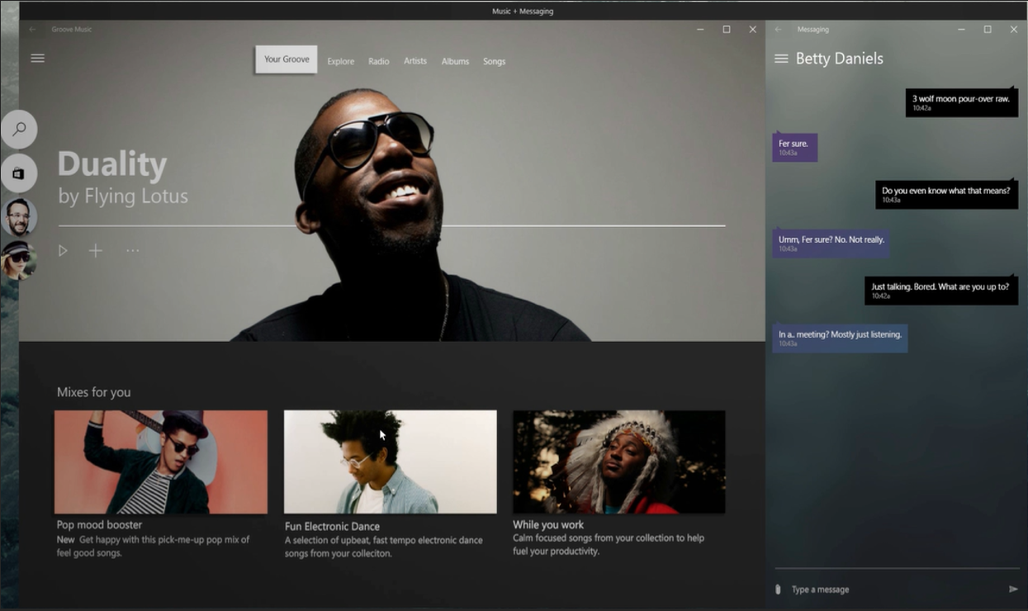
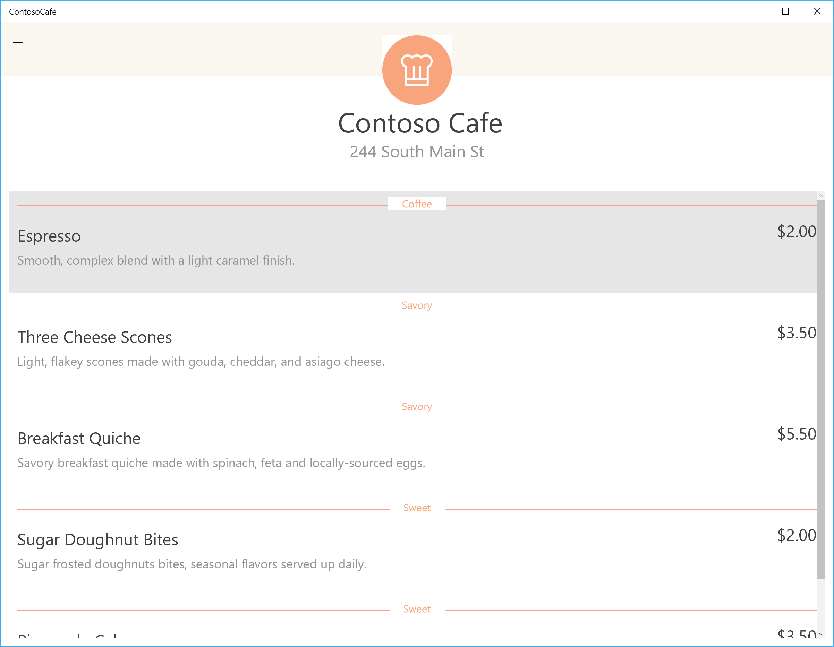
Intelligent apps
Apps loosely-coupled with bots
Apps using natural language
Apps tightly-integrated with bots
🗣 🗪

Slide 7

Incorporating AI into apps with Microsoft Cognitive Services
democratizing intelligence

Slide 8

Cognitive Services API Collection
Vision
From faces to feelings, allow your apps to understand images and video
Microsoft Cognitive Services
Give your apps a human side
Speech
Hear and speak to your users by filtering noise, identifying speakers, and understanding intent
Language
Process text and learn how to recognize what users want
Knowledge
Tap into rich knowledge amassed from the web, academia, or your own data
Search
Access billions of web pages, images, videos, and news with the power of Bing APIs

Slide 9







Why Microsoft Cognitive Services?
Easy
Flexible
Tested
Roll your own with REST APIs
Simple to add: just a few lines of code required
Integrate into the language and platform of your choice
Breadth of offerings helps you find the right API for your app
Built by experts in their field from Microsoft Research, Bing, and Azure Machine Learning
Quality documentation, sample code, and community support
GET A KEY
BUILD

Slide 10






Powering products across Microsoft
Intelligence powers our products
Vision
Speech
Language
Knowledge
Search

Slide 11
Vision
Computer Vision API
Face API
Emotion API
Video API
Distill actionable information from images
Detect, identify, analyze, organize, and tag faces in photos
Personalize experiences with emotion recognition
Analyze, edit, and process videos within your app

Slide 12
Speech
Vision
Bing Speech API
Speaker Recognition API
Custom Recognition Intelligent Service
Convert speech to text and back again, and understand its intent
Give your app the ability to know who's talking
Fine-tune speech recognition for anyone, anywhere

Slide 13



Speech
Language
Bing Spell Check API
Web Language Model API
Linguistic Analysis API
Language Understanding Intelligent Service
Text Analytics API
Detect and correct spelling mistakes within your app
Leverage the power of language models trained on web-scale data
Easily parse complex text with language analysis
Teach your apps to understand commands from your users
Detect sentiment, key phrases, topics, and language from your text

Slide 14

Language
Knowledge
Academic Knowledge API
Knowledge Exploration Service
Entity Linking Service
Recommendations API
Explore relationships among academic papers, journals, and authors
Add interactive search over structured data to your project
Contextually extend knowledge of people, locations, and events
Provide personalized product recommendations for your customers

Slide 15
Search
Knowledge
Bing Web Search API
Bing Autosuggest API
Bing Image Search API
Bing Video Search API
Bing News Search API
Connect powerful search to your apps
Give your app intelligent autosuggest options for searches
Bring advanced image and metadata search to your app
Trending videos, detailed metadata, and rich results
Link your users to robust and timely news searches

Slide 16
Demo: Intelligent Kiosk
https://github.com/Microsoft/Cognitive-Samples-IntelligentKiosk/

Slide 17
Demo
Cognitive Services APIs

Slide 18
Resources
http://microsoft.com/cognitive-services
https://www.microsoft.com/cognitive-services/en-us/documentation
https://cognitive.uservoice.com
https://github.com/Microsoft-DXTW/AzureCafe070316
https://aka.ms/cognitivesdks

